Slide 1


Getting Started with TensorFlow.js
Shubham Gupta
Google Code- in 19 Mentor
Beta Microsoft Student Partner
ML DL Enthusiast
SRM University

Slide 2
Today’s Agenda
What is TensorFlow.js and where it is used ?
Sample code-1 “using js”.
Converting a tf model .
Sample code-2 “using tf convert”
Sample code-3”using pretrained model”

Slide 3
What is TensorFlow.js ?

Slide 4
TensorFlow. Js
TensorFlow.js is a JavaScript library for training and deploying models in the browser and on Node.js
How it works
Run existing models :
Use Pre trained TensorFlow.js models
Convert Python models
2. Develop ML with JavaScript
3. Retrain existing models

Slide 5
First Thing First
Requirements :-
Browser : Prefer Chrome ( latest version )
Code editor : Prefer VS Code
Web server: Get it from chrome store
https://www.tensorflow.org/js/

Slide 6
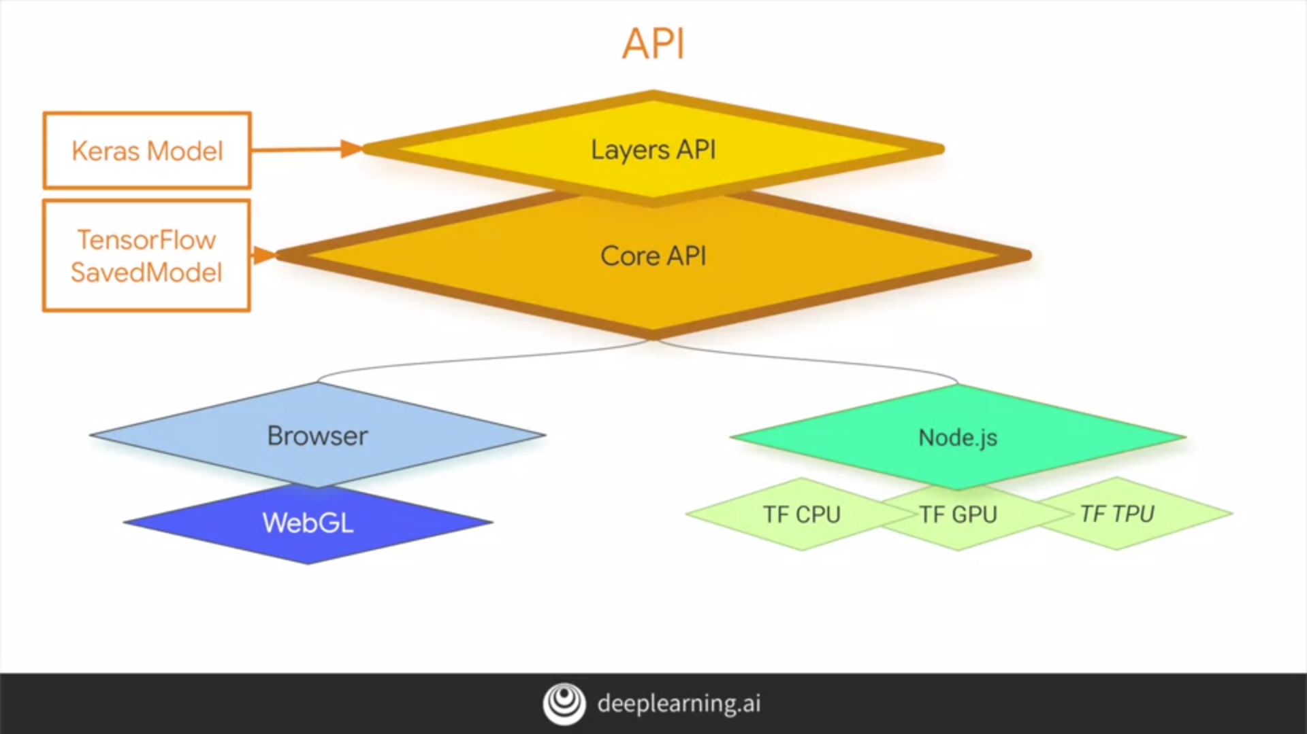

Slide 7
Sample code-1 “using js”

Slide 8
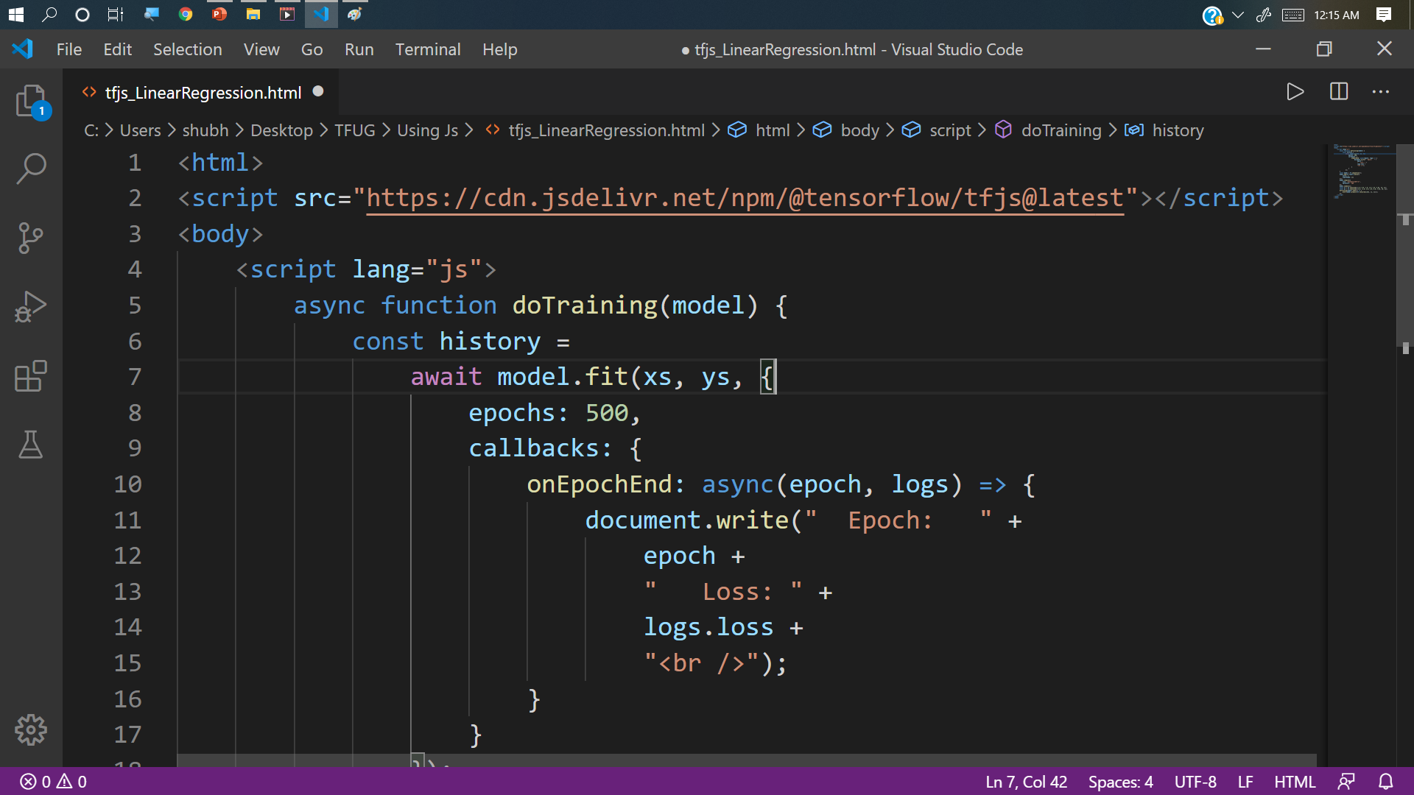

Slide 9
Converting a tf model .

Slide 10
TensorFlow.js comes with a variety of pre-trained models that are ready to use in the browser - they can be found on https://github.com/tensorflow/tfjs-models
However if we have any custom made model that we want to use in browser then :TensorFlow.js provides a model converter for this purpose.

Slide 11
The TensorFlow.js converter works with several different model formats:
Keras model: Keras models are generally saved as an HDF5 file.
SavedModel: This is the default format in which TensorFlow models are saved.
TensorFlow Hub module: These are models that have been packaged for distribution on TensorFlow Hub, a platform for sharing and discovering models.
https://www.tensorflow.org/js/guide/conversion

Slide 12
!tensorflowjs_converter --input_format=keras {"./model.h5"} ./
Lets Execute

Slide 13
Using a Pre Trained Model
MobileNet

Slide 14
Thank You

Slide 15



Want to connect with me ?
http://shubhamspeeks.me
/shubham15gupta09
/shubham15gupta09
/shubham15gupta0

